Slide 1


Creative Industry Challenges
Presented by
Arwen & Fatima

Slide 2


Scenario
A Mom was eagerly preparing for her daughter’s birthday party, envisioning a magical day filled with laughter and fun. However, amidst her busy days of errands and work deadlines. the tasks and logistics of planning decorations, games, and activities felt overwhelming and daunting, particularly with the need to stay within her budget.
Simply Eventful

Slide 3
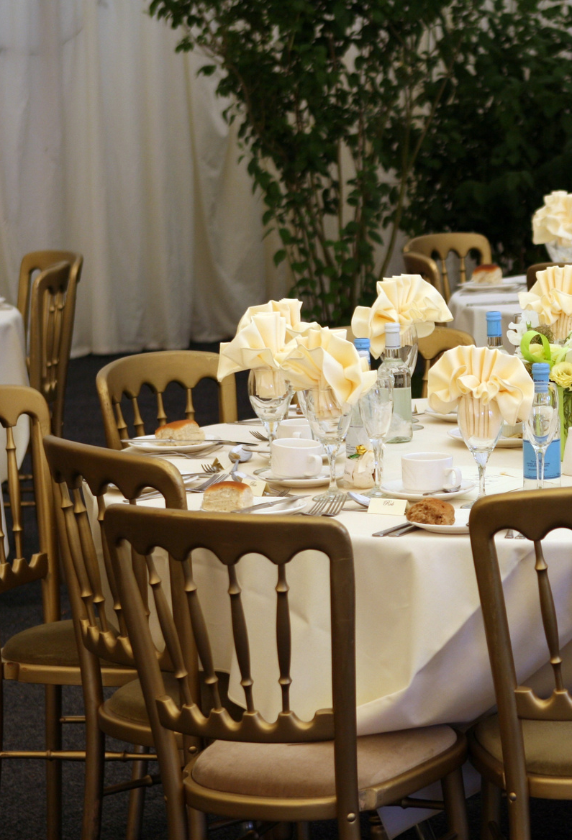
Who We Are
Simply Eventful is an event planning service different from other event planning services focusing on catering better to its clients needs.
Customer satisfaction is our top priority, which is why our prices are budget-friendly and accessible to all.

Slide 4
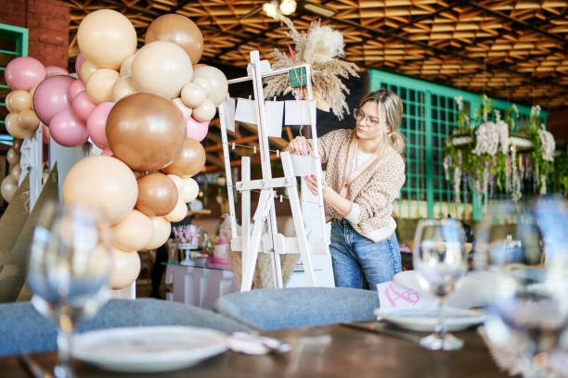
Target Audience
Families
Big or Small Gatherings
Businesses
etc.
Simply Eventful
Audience Interests
A quality and affordable option in the event-coordinating space to host fun and memorable events. From parties to weddings to corporate events for all sorts of people and flexible prices according to client needs.

Slide 5



Market Research
Cost
Advantages
Disadvantages
Their services and rentals are far from budgetary.
Not very suitable for small events.
Starting from 2000 AED
Wide portfolio.
Huge selection of services.
Simply Eventful
The website lacks a professional appearance.
Absence of pricing throughout.
A lack of indication to a physical address.
Very creative ideas.
Focus on minute details.
Great for small events.
Not mentioned.
Unique, stylized events.
High-quality and prestigious.
Suitable for weddings and big gatherings.
There’s no website.
No details about the service anywhere.
Not mentioned.

Slide 6









Key Features
User-Centered
Informative
Versatile
Simply Eventful
Simply Eventful focuses on making an event based on a client’s desires and budgetary needs.
The website includes the necessary information to ensure that clients are aware and informed.
Assists in various kinds of event planning service such as venue searching, program planning, food catering, etc.
Collaborative
Reliable
Eco-friendly
We actively becomes a part of its clients’ teams throughout the event planning process to ensure there’s a personalized and exceptional experience.
Simply Eventful will assist in designing, planning and managing every project of the event from planning to execution and will not stop or do things halfway.
We are environmentally conscious and committed to using organic and recycled materials.

Slide 7



Limitations
Simply Eventful requires time to create quality events. otherwise, the event might not be as qualified with the limited time. However, we always ensure to present the best event with the given budget and time.
1
Simply Eventful
The website doesn’t have all information available yet as it’s still under development. The team also has no AI generated messaging feature and is not available 24/7 to discuss the needs and requirements of the clients.
2

Slide 8
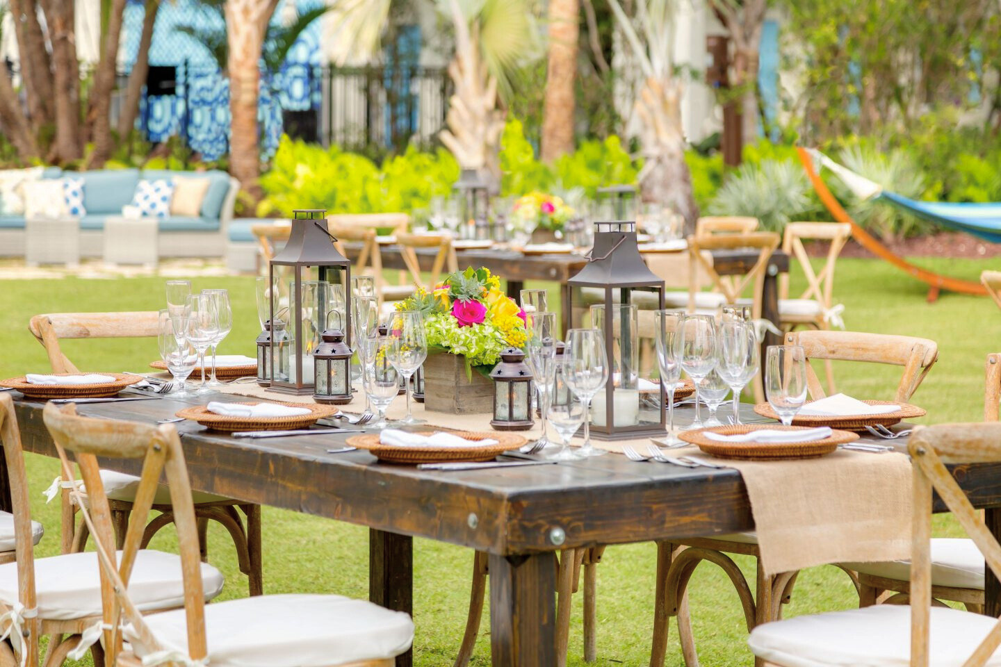
WHY US?
Catering to Your Budget:
We understand that every penny counts. Our affordability will make sure that your event dreams dont break the bank.
No one is excluded:
From families to students, big or small businesses, we welcome all! We’ve tailored our services to suit the needs of diverse clients.
Simply Eventful
Quality and Affordability:
We have the best blend of quality and affordability you’ll ever find. Your events will be fun and memorable, it is our specialty.
JOIN US!
Choose Simply Eventful for an unforgettable celebration that leaves a lasting impression.

Slide 9
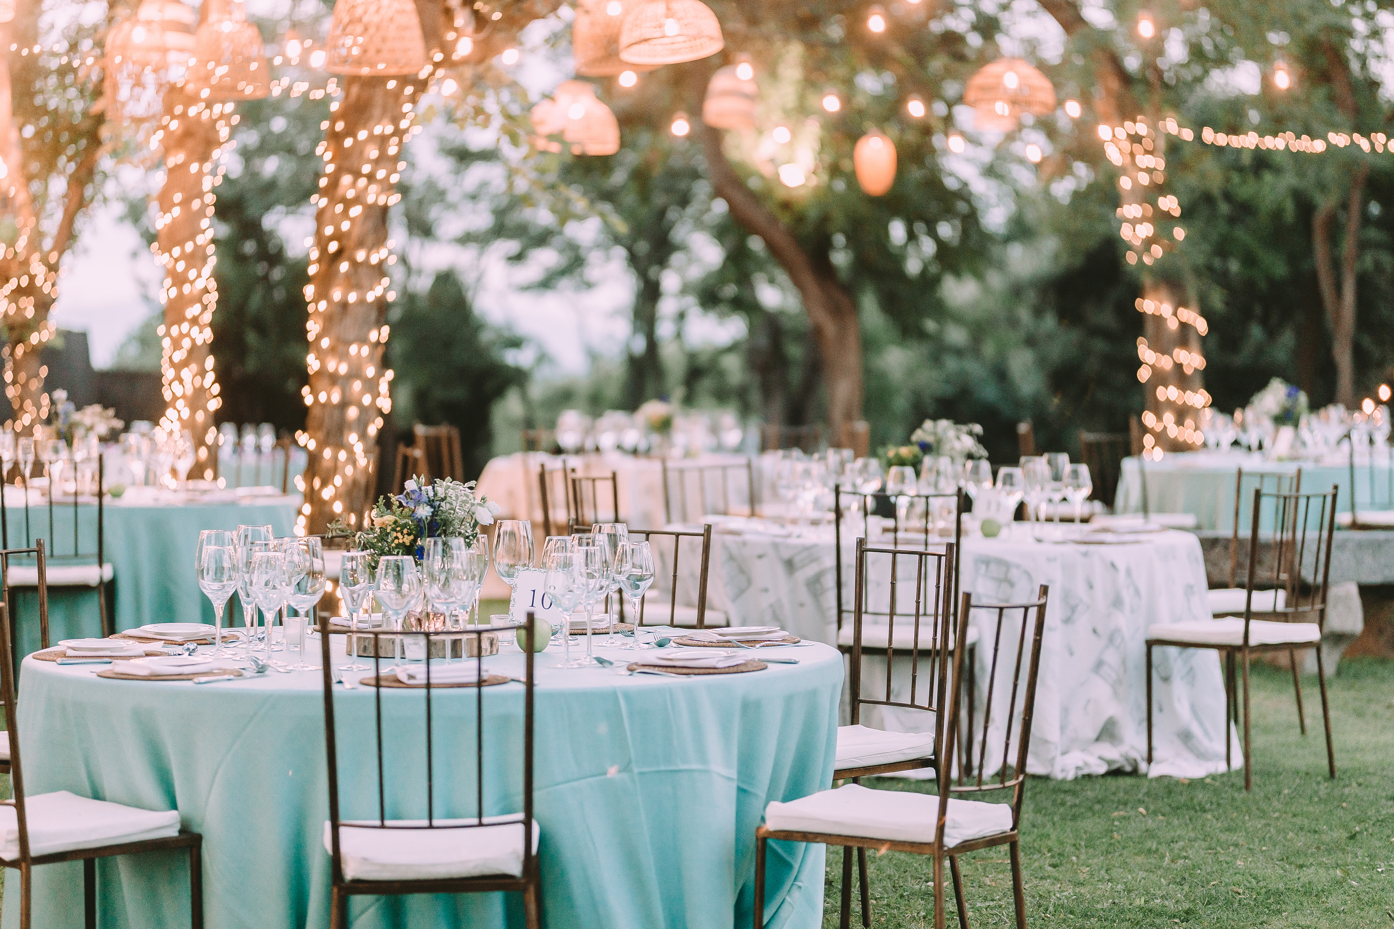
Thank You!
Thank you for considering Simply Eventful as your trusted partner in event planning management. We look forward to the possibility of revolutionizing your events.
www.simplyeventful.com

